Slide 1

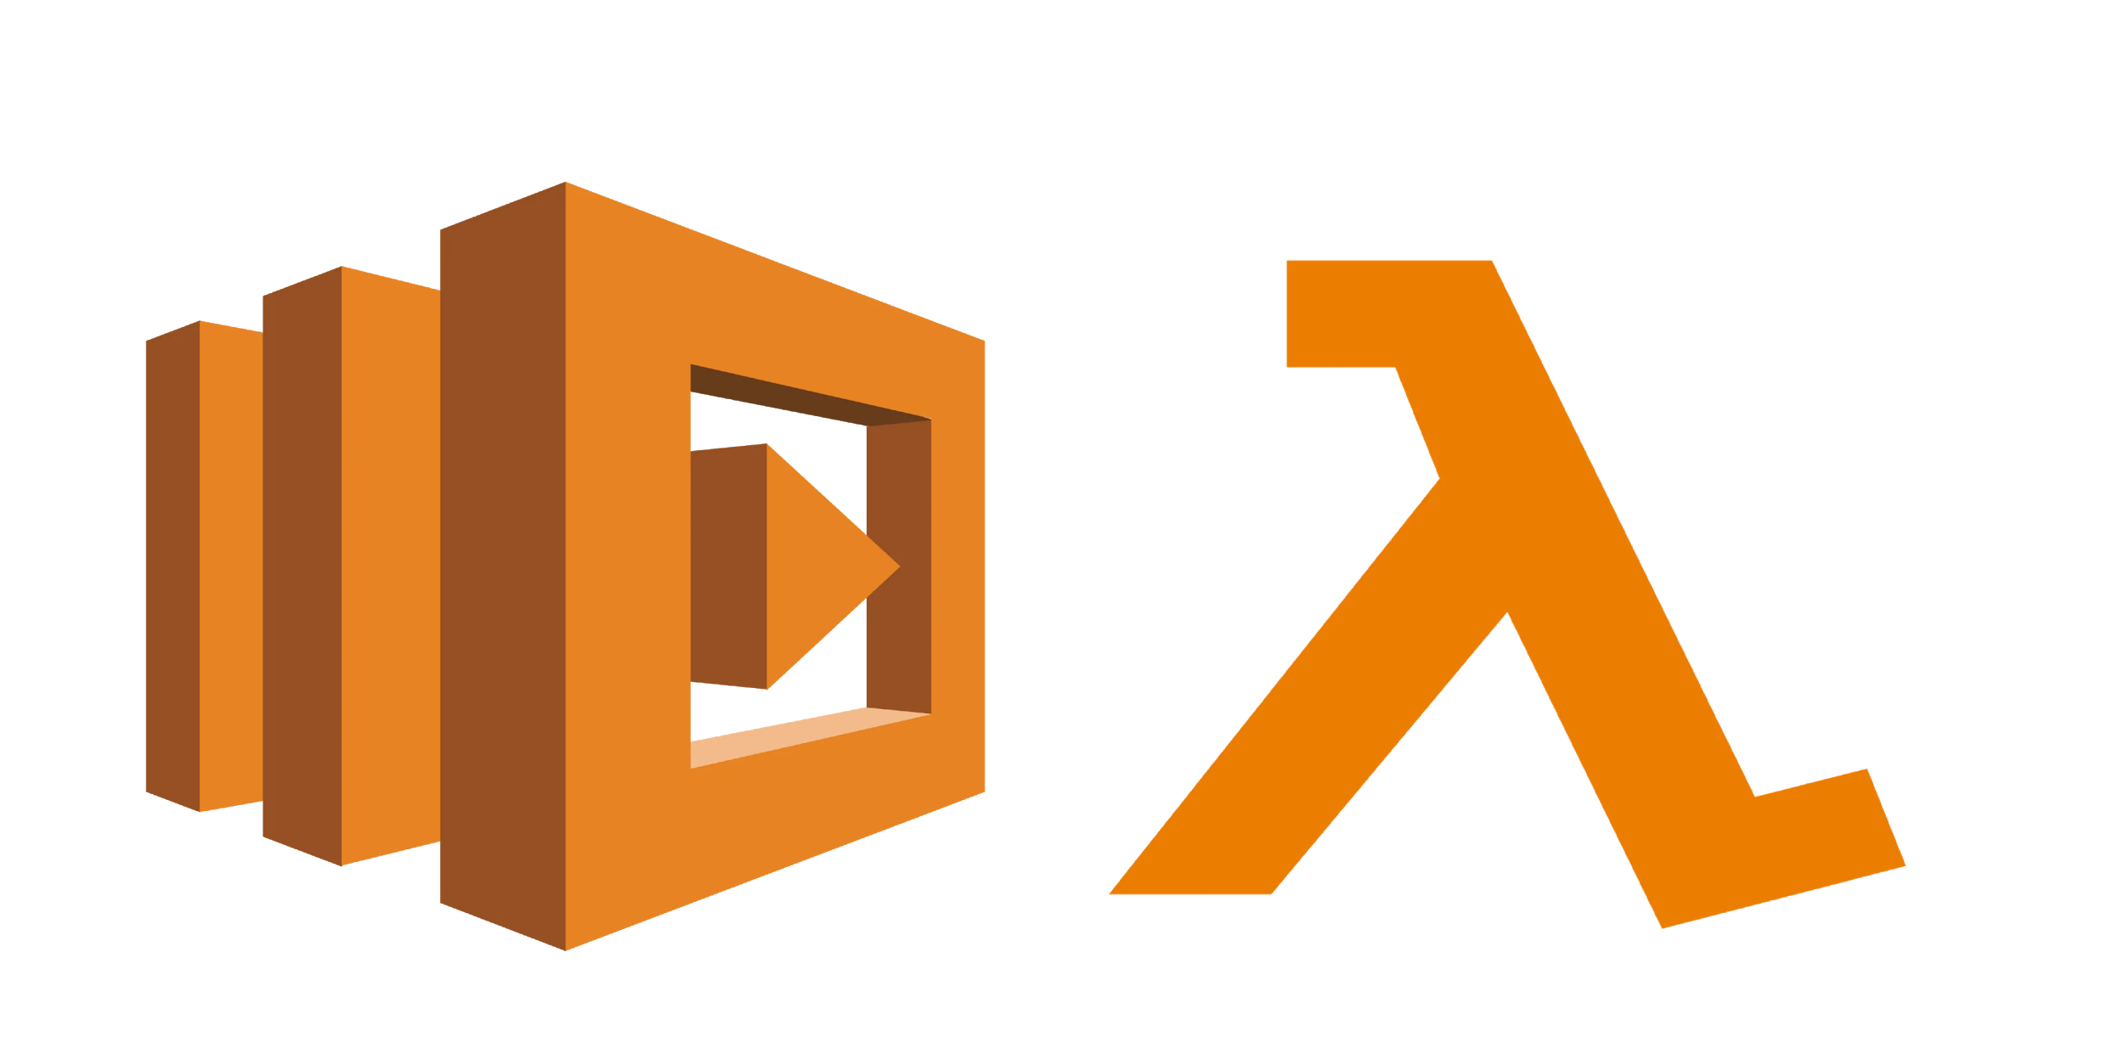
AWS LAMBDA

Slide 2
INTRODUCTION
AWS Lambda is an Amazon Web Services compute service that runs your back-end code in response to events and manages compute resources for you.
The code running on AWS Lambda is called a Lambda function.
You can write your code in the integrated editor within the AWS management console OR
if your code requires custom libraries, you can create a .ZIP file containing all necessary components upload it as a codebase
You can also select from pre-built samples, or blueprints.
Code can be written in JavaScript using Node.js, Python, .NET, Ruby, Go or in Java.
A Lambda function contains code, dependencies, and configuration information
Configuration includes information like the handler that will receive the event, the AWS Identity and Access Management (IAM) role that AWS Lambda can use to execute the Lambda function

Slide 3
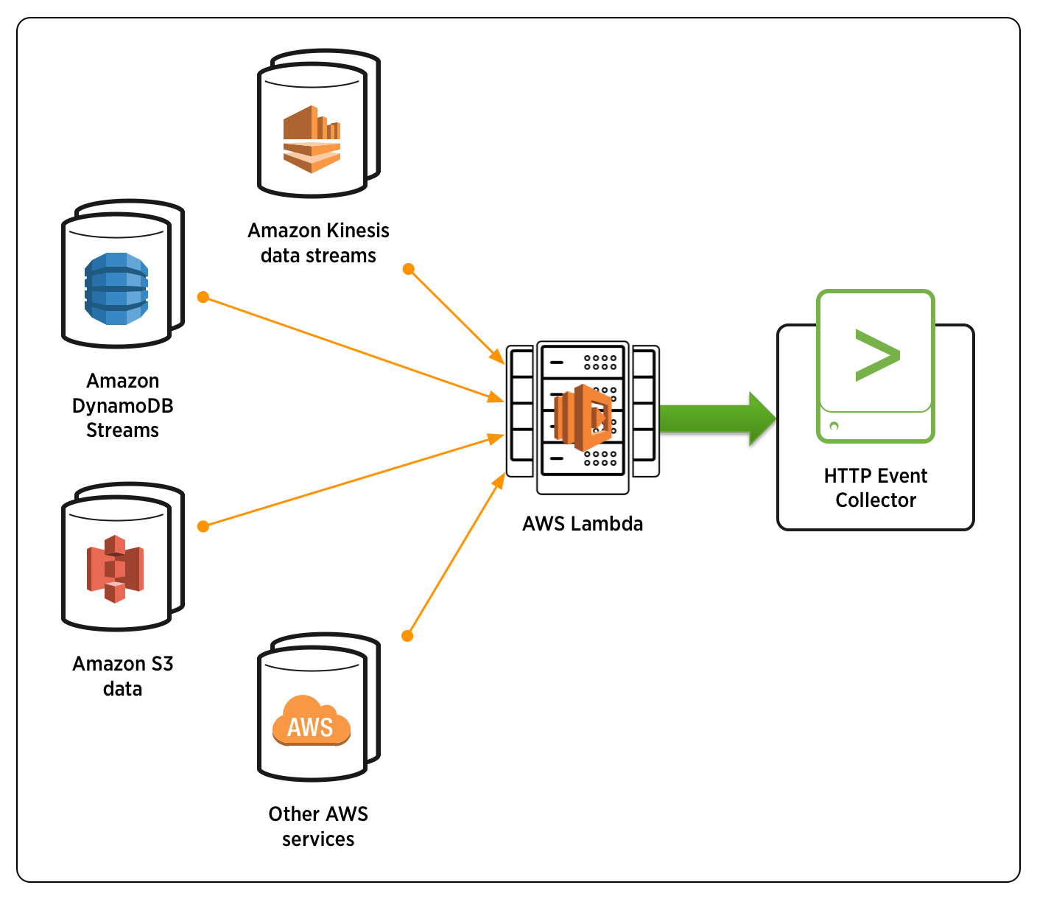

AWS Lambda can receive event data from multiple sources as shown below and perform various operations to provide required response.

Slide 4
Example : Lambda + Dynamo DB + API Gateway
We will create a Lambda function that will fetch values from our Dynamo DB table.
Steps :
Open the Functions page on the Lambda console.
Choose Create function.
Under Basic information, do the following:
For Function name, enter my-function.
For Runtime, confirm that Python 3.8 is selected.
Choose Create function.
Now, we need to create an API Gateway and link it to our Lambda function.
API Gateway :
Steps:
Choose API Gateway.
For API, choose Create an API.
For Security, choose Open.
Choose Add.

Slide 5
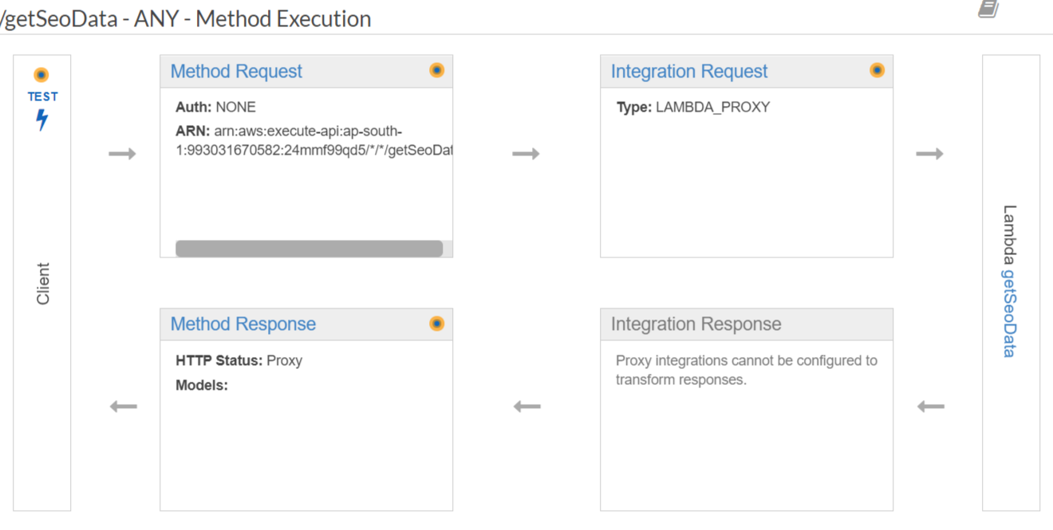
To add a public endpoint to your Lambda function
Open the Functions page on the Lambda console.
Choose a function.
Under Designer, choose Add trigger.
Choose API Gateway that we have created earlier.
Execution :

